Slide 1
Which impact have macroeconomic variables on the NaSDAQ COMPOSITE INDEX price return?
University of Bern, CAS in Applied Data Science, 7 OCTOBER 2021
Thomas parmentier & Stefan

Slide 2
Project objectives
Research objective:
The objective of this research is to examine the impact of some macroeconomic factors on the stock market returns of the NASDAQ composite index . We will use the Multivariate Regression Model based on the Ordinary Least Squared (OLS) method to test the relationship between the macro variables and the return of the NASDAQ composite index price return
Abstract:
Macroeconomic variables affect the performance of the stock market. Investors consider macroeconomic variables when they value stocks. Interest rates, unemployment, inflation and GDP are very important among these macroeconomic variables which are often used to explain stocks price performance.
We use four independent variables: US GDP, US CPI, US Interest rates, US Unemployment rates and one dependent variable: Nasdaq composite index price return

Slide 3
Simplified work flow
Fed Saint-Louis timeseries for independent variables
Loading the data into Jupyter
Unit root test then first / second difference
Ordinary Least Squared (OLS)
Diagnostic of the residuals
Cleaning, merging
Nasdaq time series for dependent variable

Slide 4
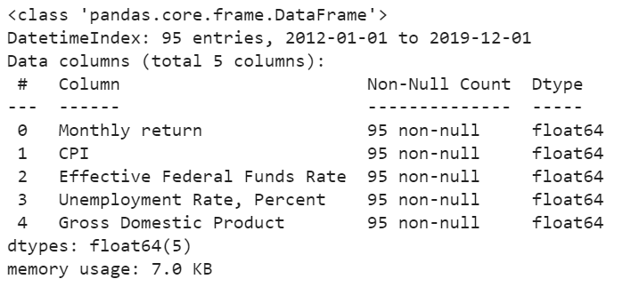
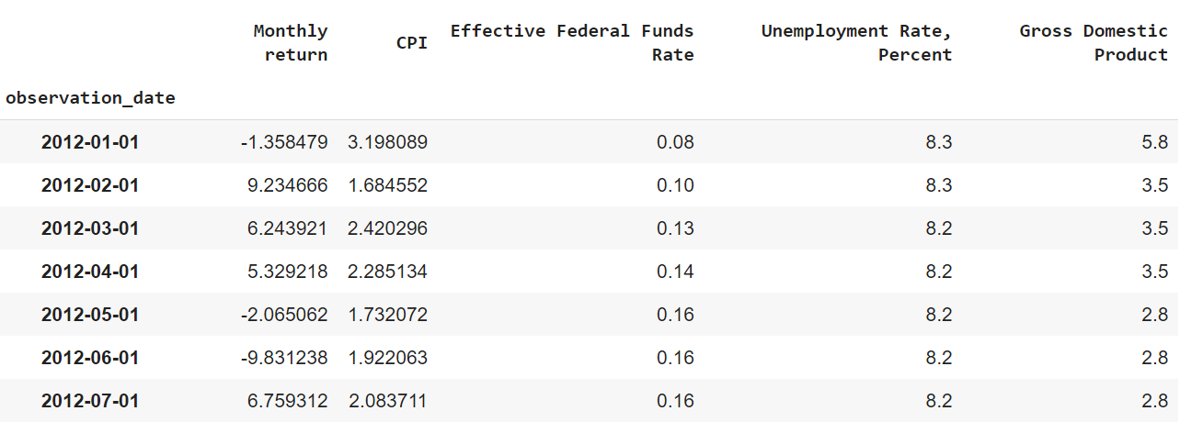
Data set description
Date set description: The data set consists of 95 instances
There are 4 independent variables:
-US GDP: We use GDP in percent change from Preceding Period, Monthly, Seasonally Adjusted Annual Rate.
-US CPI: Growth Rate Same Period Previous Year, Monthly, Seasonally Adjusted.
-US Interest rates: Effective Federal Funds Rate, Percentage, Monthly, Not Seasonally Adjusted.
-US Unemployment rate in Percentage, Monthly, Seasonally Adjusted.
Dependent variable:
-Nasdaq composite index, which is a stock market index and includes almost all stocks listed on the Nasdaq stock exchange. The index is heavily weighted towards Information Technology / Communication sectors
Sources: Fed Saint Louis & Nasdaq

Slide 5
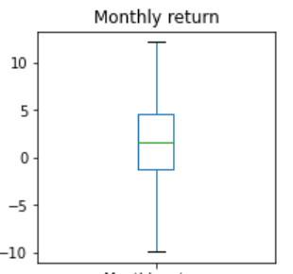
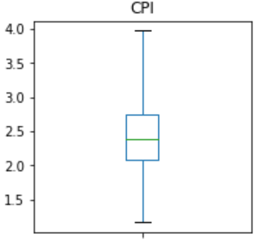
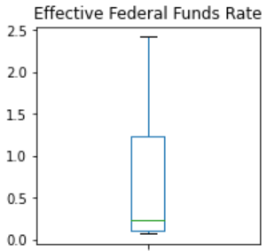
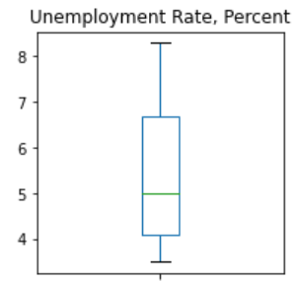
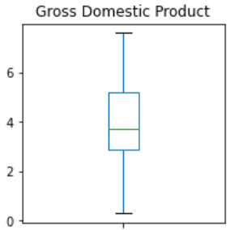
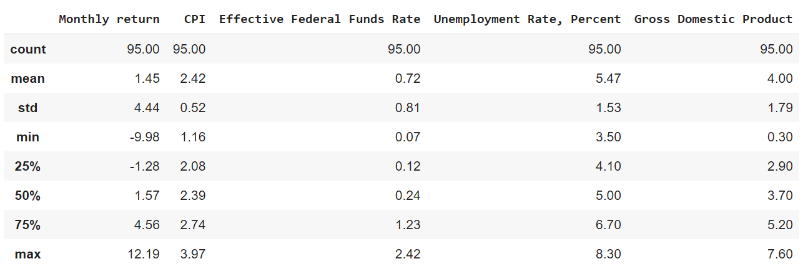
Descriptive statistics
The dataset has been analysed using box-plots and descriptive statistics
We are checking for outliers

Slide 6
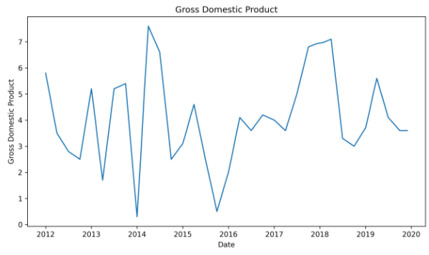
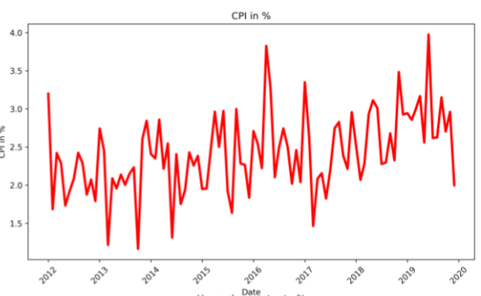
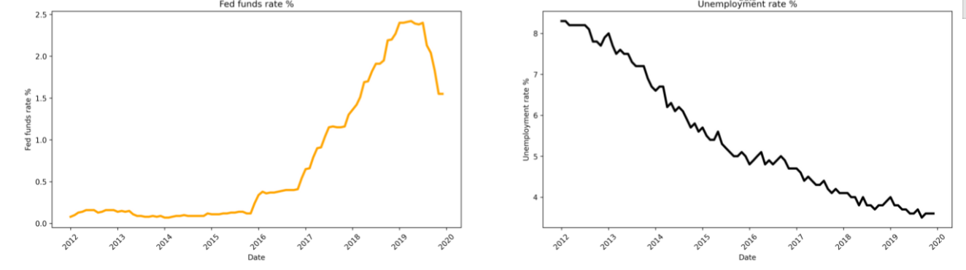
Independent variables - charts

Slide 7
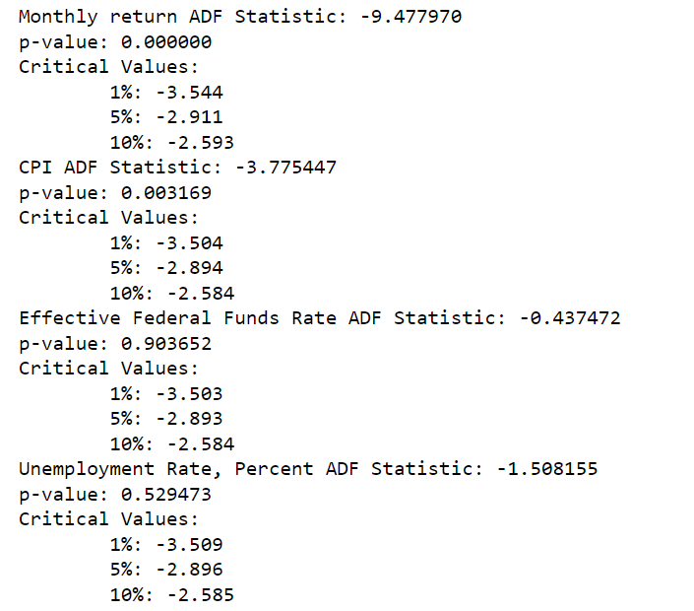
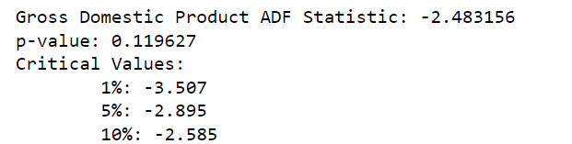
Stationarity - Test for UNIT-ROOT
We tested for stationarity using the Augmented Dickey-Fuller test.
H0: p-value > 0.05: Fail to reject the null hypothesis, the data has unit root and is non-stationary. It has some time dependent structure.
H1: p-value <= 0.05: Reject the null hypothesis, the data has no unit root and is stationary.
The results suggest that we can reject the null hypothesis for the Monthly return and CPI. Data are non-stationary for Fund rate, Unemployment and GDP
We need to take the first difference of those variables

Slide 8
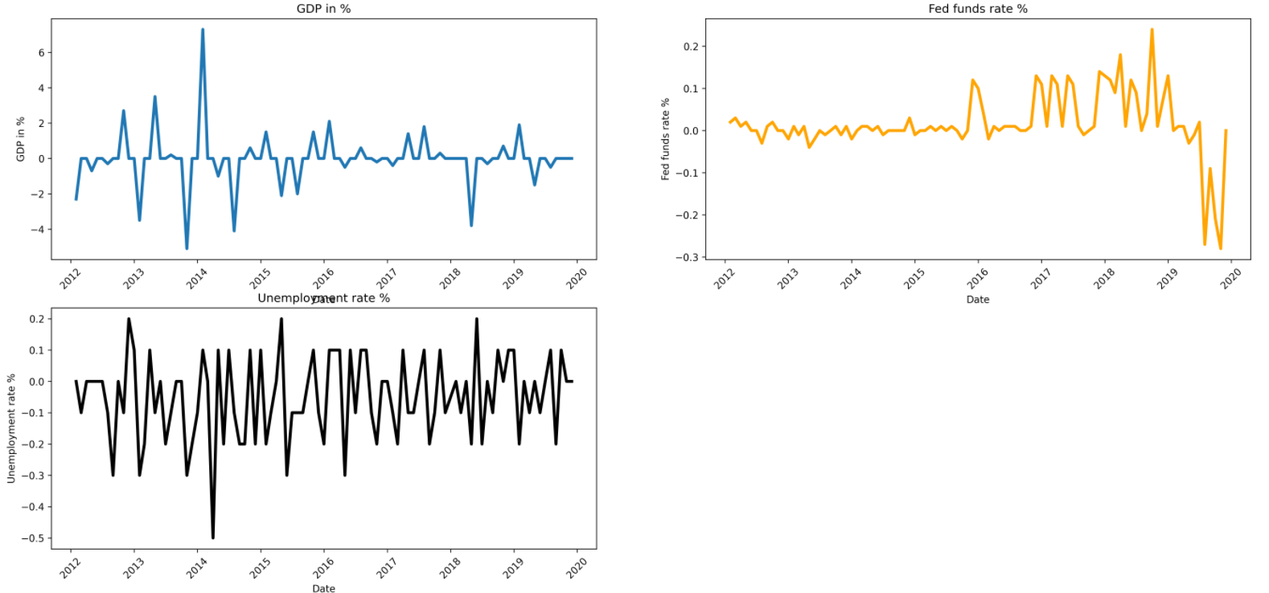
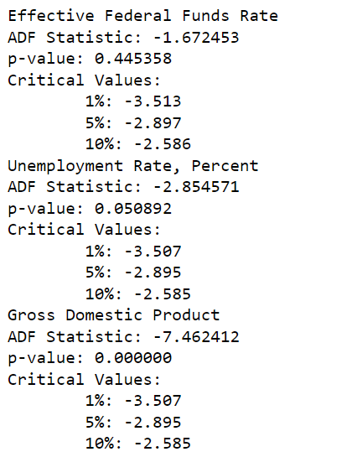
first difference
We use the same H0 / H1 hypotheses
The results suggest that we can reject the null hypothesis for the GDP. Unit root is still present for Fund rate, Unemployment
We need to take the second difference of those variables

Slide 9
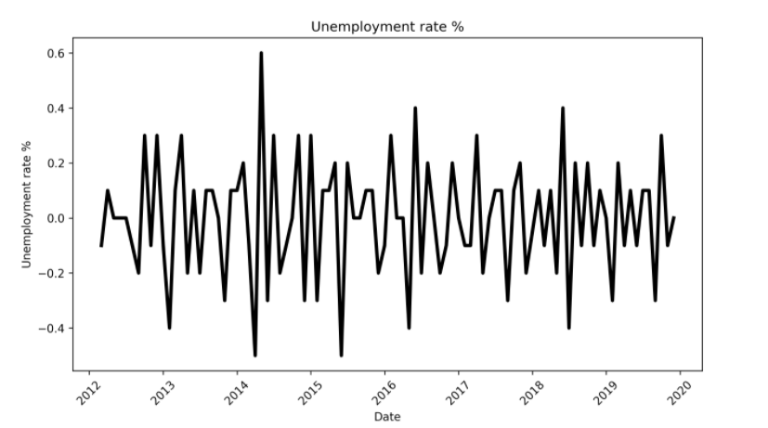
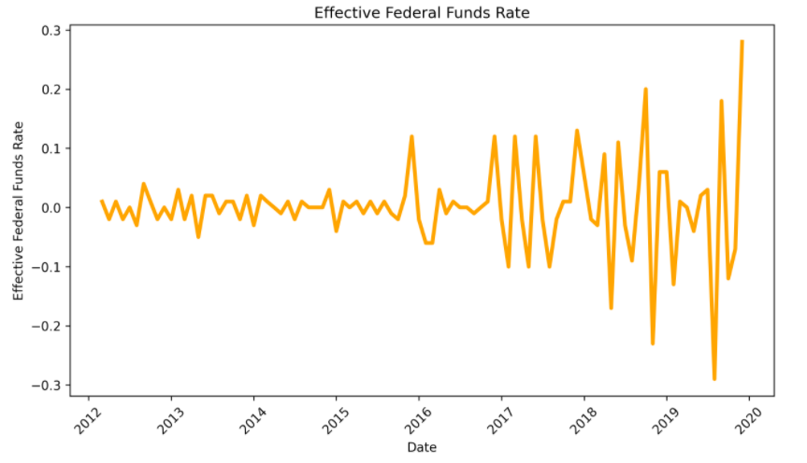
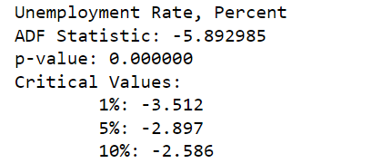
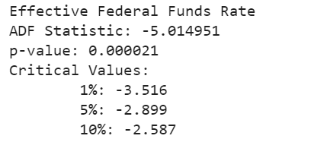
Second difference
We use the same H0 / H1 hypotheses
The results suggest that we can reject the null hypothesis for the Unemployment and fund rate.

Slide 10
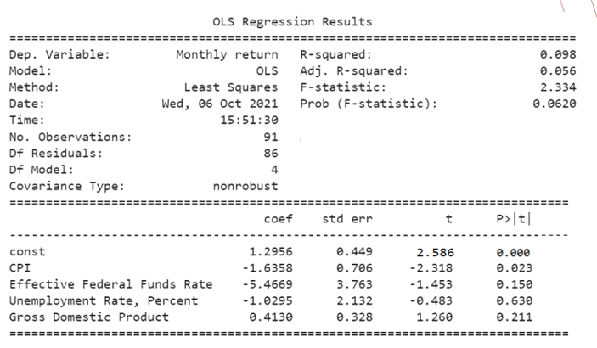
OLS regression results
-To analyze the relationship between the variables and the Nasdaq we run an OLS Regression.
-Despite being small the sign coeffs look as we would expect.
-The output shows a significant relationship between CPI and stock price.
. -Although the other macroeconomic variables are not significant, their coefficient signs confirm our expectations for those variables
Our OLS equation is as follows:
(Nasdaq Monthly Return)t = α1 + β1*(CPI)t + β2SD* (Federal fund rates)t + β3SD *(Unemployment rate)t + β4FD * (GDP)t + εit
FD = First difference
SD = Second difference

Slide 11
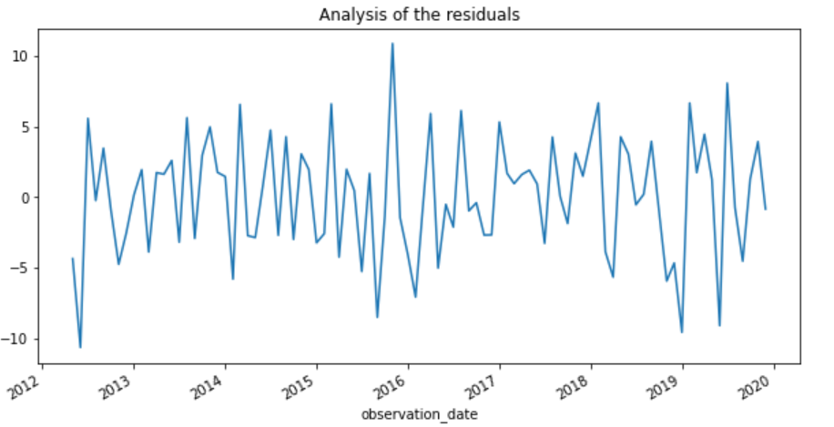
Residual analysis
-We analyze the residuals to check for white noise.
The timeseries shows a mean of zero, Std looks constant and no autocorrelation

Slide 12
Conclusion
On the basis of the above overall analysis, it can be concluded that one out of the four selected macroeconomic variables are relatively significant and likely to influence monthly return of the Nasdaq composite index.
Next steps could be:
-Use filters on the dataset (moving average…)
-Select other macro variables
-Split macro variables between expected and unexpected observations
Github: https://github.com/parment1/Project-M1-M2

Slide 13
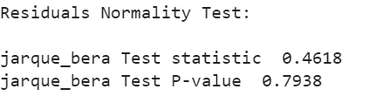
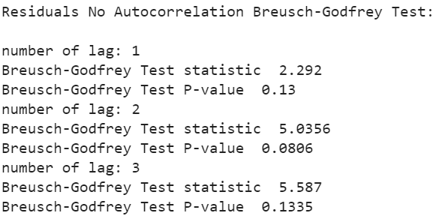
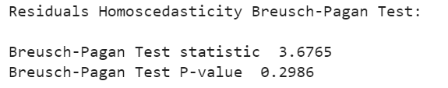
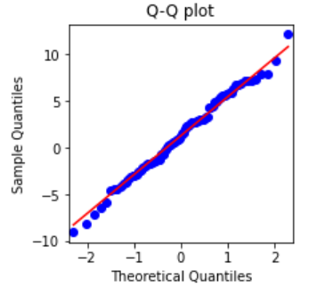
Appendix: Residual analysis
AUTOCORRELATION
The presence of serial correlation is examined by Breusch-Godfrey Test. Residuals for OLS output is tested for serial correlation, using the following hypothesis:
H0 : No autocorrelation
H1 : Autocorrelation
HETEROSCEDASTICITY
This test is important to confirm the robustness of the OLS output since we cannot rely on them in the presence of heteroscedasticity:
H0: No heteroscedasticity
H1: Heteroscedasticity
NORMALITY
This test is important to find out whether the error term follows normal distribution:
H0: Residuals are normally distributed
H1: Residuals are not normally distributed
The p-value is 0.79 greater than the critical value at the 5% level. So, the null hypothesis cannot be rejected
The p-value is 0.3 which is greater than critical value at 5%. We cannot reject the null hypothesis and we can conclude there is no heteroscedasticity is present, and thus OLS t-test results can be trusted.
The p-value is 0.13 which is greater than critical value at 5%. We cannot reject the null hypothesis and we can conclude for the absence of autocorrelation.

Slide 14
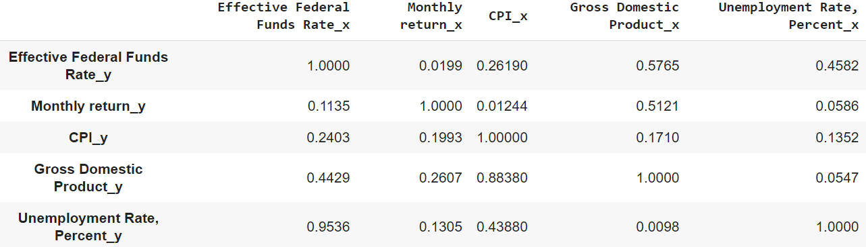
Appendix : Granger causality test
p-value
The rows are the responses (y) and the columns are the predictors (x). If a given p-value is < significance level (0.05), we can reject the null hypothesis.
H0 : Yt does not “Granger cause” Xt+1
H1: Yt does “Granger cause” Xt+1
Here we can see that CPI_X causes Monthly return_Y but not the other way around.

Slide 15
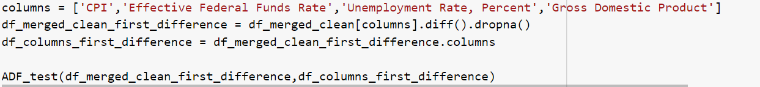
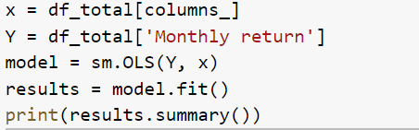
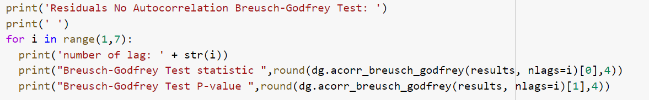
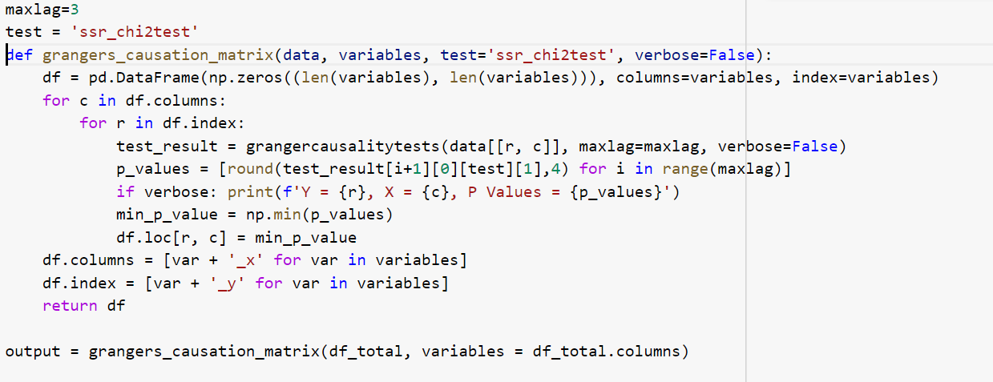
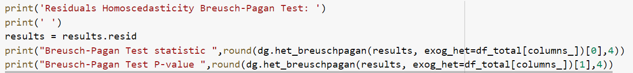
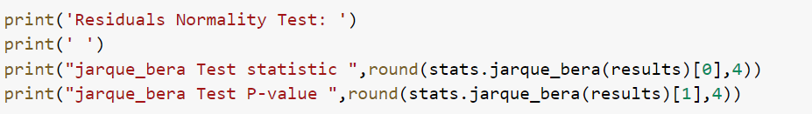
Appendix : Python codes for unit root, ols and granger causality and residual tests
Augmented Dicked Fuller test
OLS
Autocorrelation test
GRANGER CAUSALITY TESTS
Heteroscedasticity test
Normality Test

Slide 16
REFERENCES
https://www.schroders.com/en/insights/economics/covid-19-why-the-tech-giants-have-emerged-as-winners/
Asset returns and inflation, Eugene F.Fama and G.William Schwert, November 1977, Journal of Financial Economics , volume 5, issue 2
Causal relations among stock returns and macroeconomic variables in a small, open economy Øystein Gjerde and Frode Sættem Journal of International Financial Markets, Institutions and Money, 1999, vol. 9, issue 1, 61-74

